Slide 1

Wireless Communication
“Unplugged but Connected”
陆俊安/韩雍睿馨/陈耀信/鲁周徵/翟云天/Shrestha/黄立刚
——2023/9/11

Slide 2

Contents
01
Principles of wireless communication
陆俊安 202130430195
02
Overview of wireless communication transmission types
韩雍睿馨 202130430386
03
Mobile network
陈耀信 202130430027
04
WIFI technology
06
Bluetooth
鲁周徵 202130430393
Shrestha Manish 202169990213
05
NFC
07
The future
翟云天 202130430034
黄立刚 202130430065

Slide 3


01
Principles of
Wireless Communication
why wireless communication is possible?
（by Ngon 陆俊安 202130430195）

Slide 4
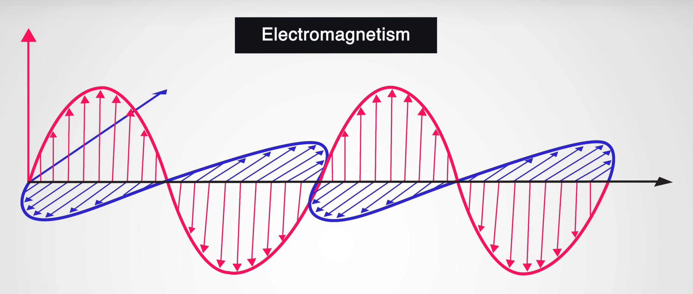
Principles of Wireless Communication
陆俊安 202130430195
In 1865…
Maxwell predicted the existence of waves.
In 1887…
Hertz proved the existence of waves through the experiment.
—— Their discoveries laid the foundation for wireless communication!

Slide 5
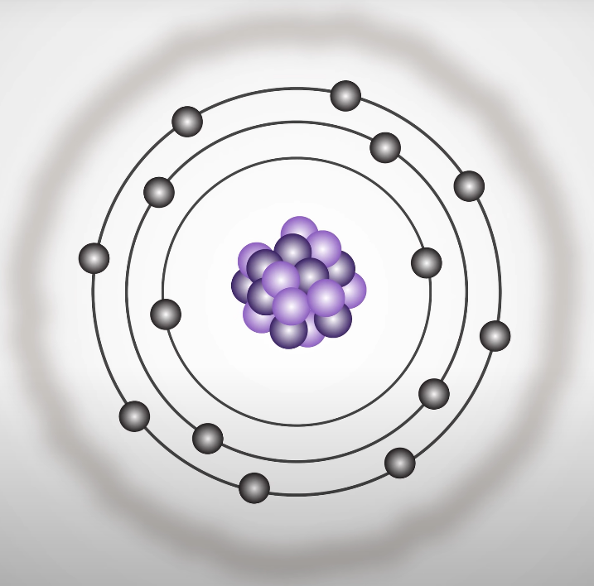
Principles of Wireless Communication
陆俊安 202130430195
Producing waves
Whenever charged particles move, they can produce changing electric and magnetic fields.
When these fields propagate through space, we get electromagnetic waves.

Slide 6
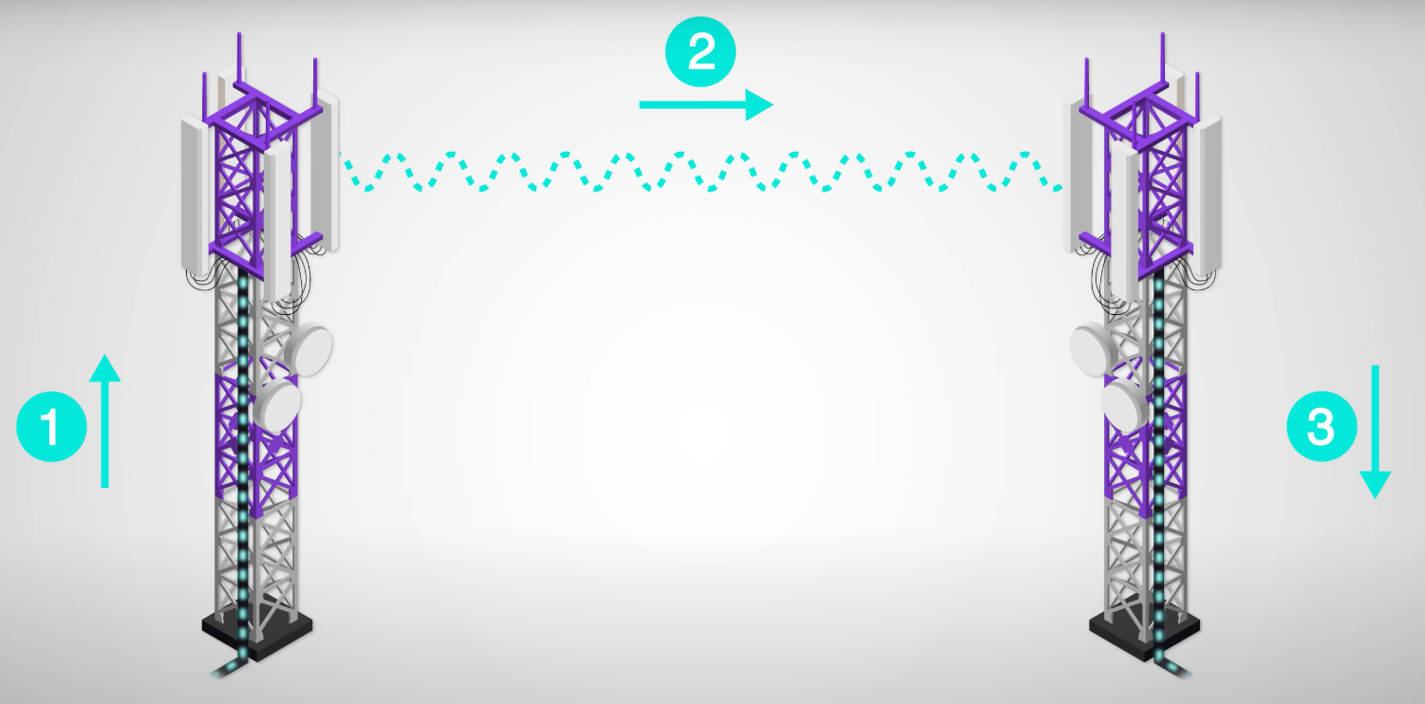
Principles of Wireless Communication
陆俊安 202130430195
Transmission
Control the movement of charged particles to emit waves at a specific frequency.
Wave affect the movement of charged particles to recreate the corresponding current.

Slide 7
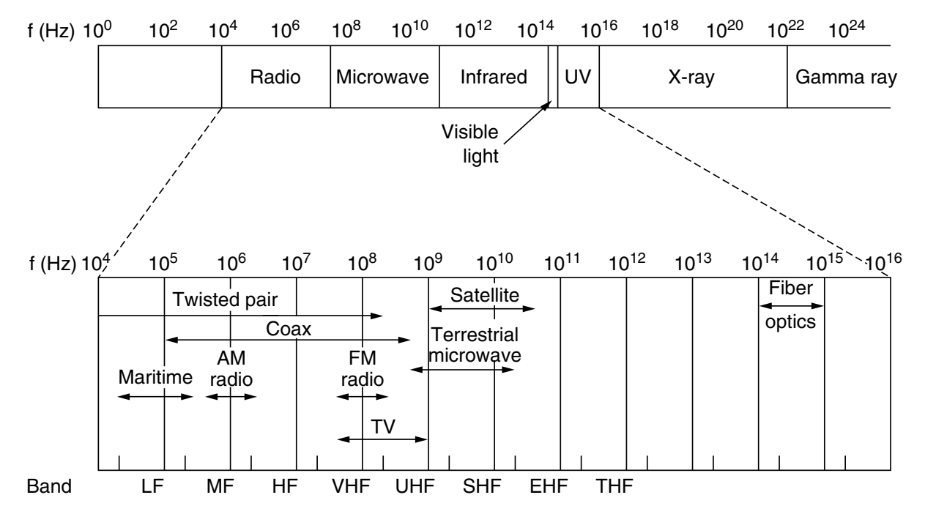
Principles of Wireless Communication
陆俊安 202130430195
Transmission
Control the movement of charged particles to emit waves at a specific frequency.
Wave affect the movement of charged particles to recreate the corresponding current.

Slide 8
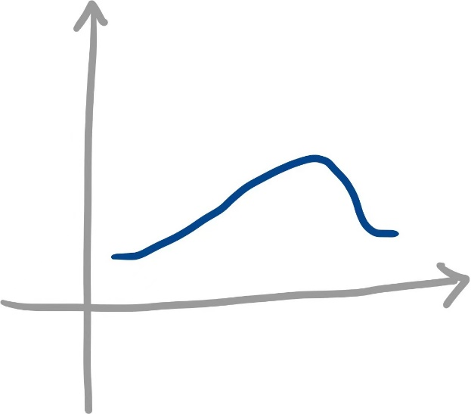



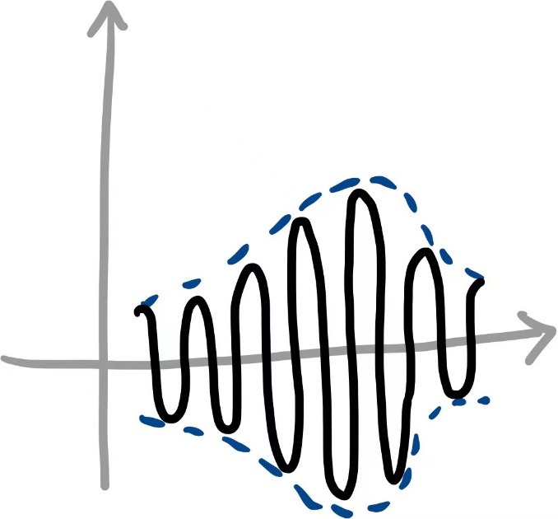

Principles of Wireless Communication
陆俊安 202130430195
VS

Slide 9
02
Overview of wireless communication transmission types
韩雍睿馨 202130430386

Slide 10
1.Radio transmission
2.Microwave transmission
3.Infrared transmission
4.Optical communication

Slide 11
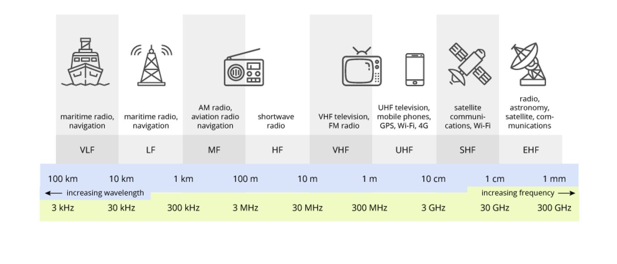
1.Radio transmission

Slide 12
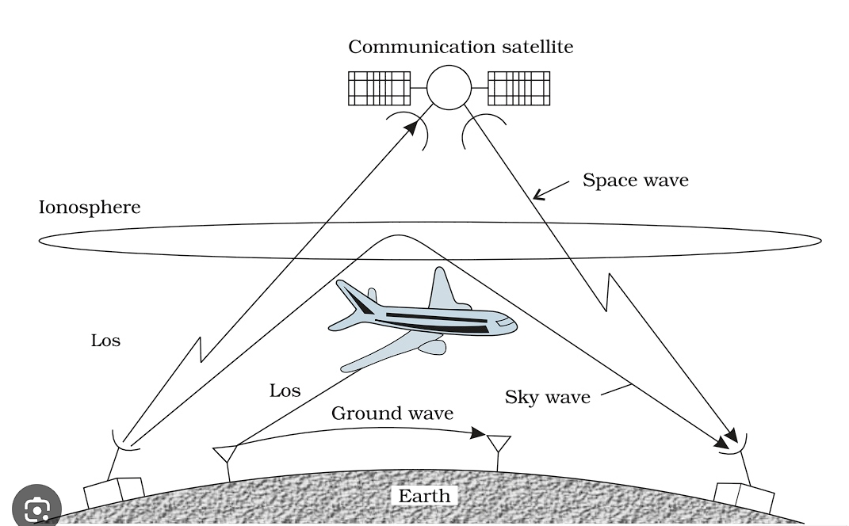

Slide 13
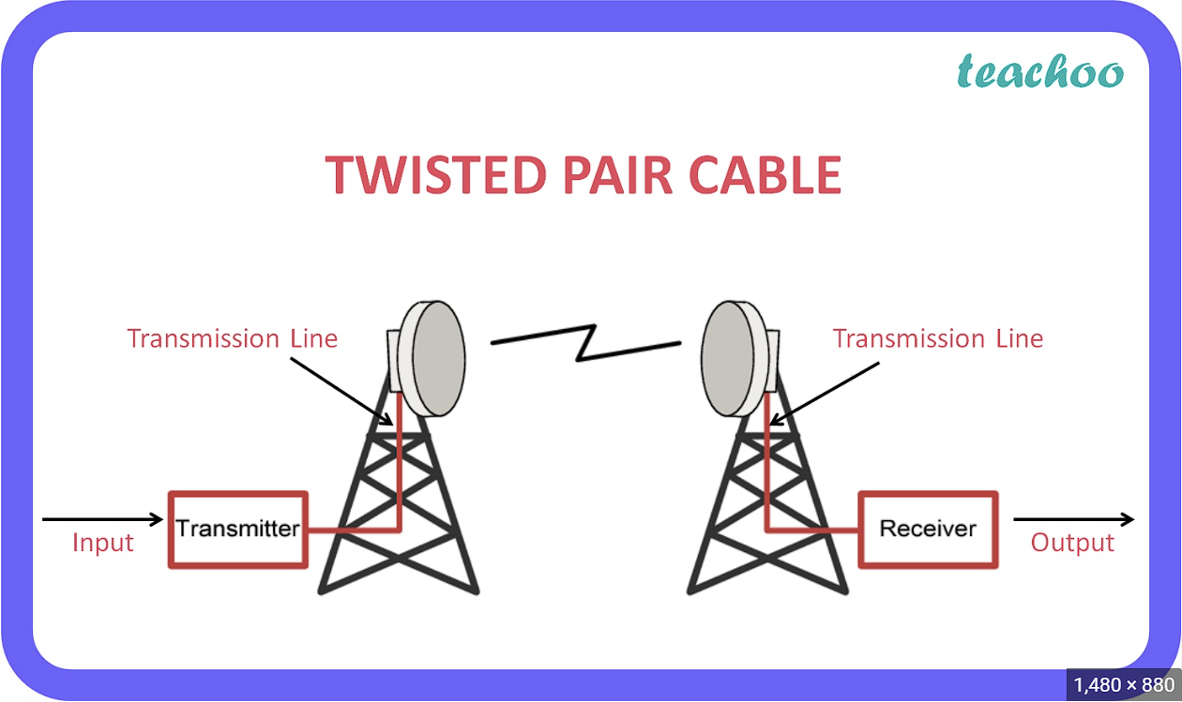
2.Microwave transmission

Slide 14
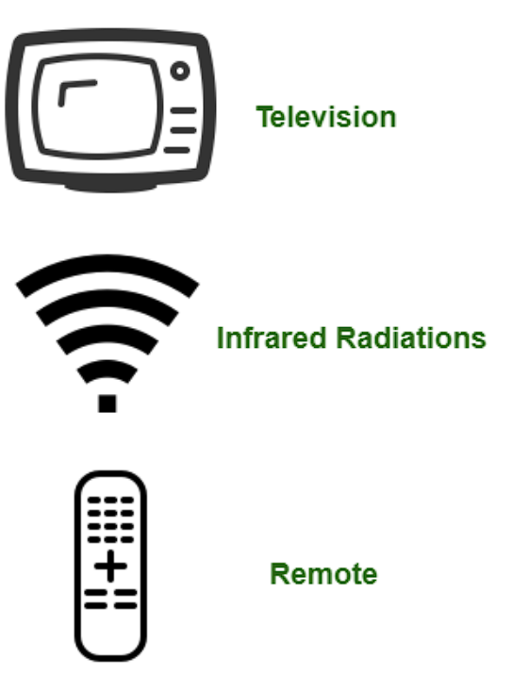
3.Infrared transmission

Slide 15
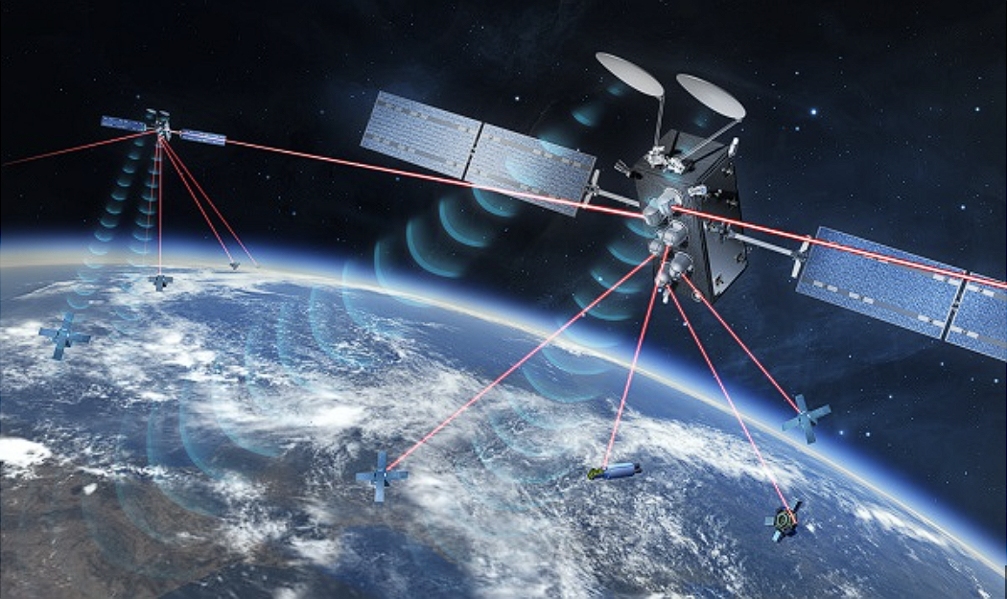
4.Optical communication

Slide 16
Mobile network
5g band distribution
Baseband chip
Mobile network and 5g from an overall perspective
Everyone has a tiny modem in their phone

Slide 17
Frequency band number | Uplink(MHz) | Downlink(MHz) | Bandwidth(MHz)
n1 | 1920-1980 | 2110-2170 | 60
n2 | 1850-1910 | 1930-1990 | 60
n3 | 1710-1785 | 1805-1880 | 75
n5 | 824-849 | 869-894 | 25
n7 | 2500-2570 | 2620-2690 | 70
n8 | 880-915 | 925-960 | 35
n20 | 832-862 | 791-821 | 30
n28 | 703-748 | 758-803 | 45
n38 | 2570-2620 | 2570-2620 | 50
n41 | 2496-2690 | 2496-2690 | 194
n50 | 1432-1517 | 1432-1517 | 85
n51 | 1427-1432 | 1427-1432 | 5
n66 | 1710-1780 | 2110-2200 | 70/90
n70 | 1695-1710 | 1995-2020 | 15/25
n71 | 663-698 | 617-652 | 35
n74 | 1427-1470 | 1475-1518 | 43
n75 | N/A | 1432-1517 | 85
n76 | N/A | 1427-1432 | 5
n77 | 3300-4200 | 3300-4200 | 900
n78 | 3300-3800 | 3300-3800 | 500
n79 | 4400-5000 | 4400-5000 | 600
n80 | 1710-1785 | N/A | 75
n81 | 880-915 | N/A | 35
n82 | 832-862 | N/A | 30
n83 | 703-748 | N/A | 45
n84 | 1920-1980 | N/A | 60
n257 | 26500- 29500 | 26500- 29500 | 3000
n258 | 24250-27500 | 24250-27500 | 3000
n260 | 37000-40000 | 37000-40000 | 3000
n261 | 27500-28350 | 27500-28350 | 850
5g band distribution
After the standards-setting organization 3GPP allocated the 5G frequency band in the picture on the right, communications departments and operators in various countries began to develop specific frequency bands. So not all frequency bands will be used in every country.

Slide 18
5g band distribution
Operator | Frequency band number | Frequency Range(MHz) | Bandwidth(MHz)
China Mobile | n41 | 2515-2675 | 160
 | n79 | 4800-4900 | 100
China Telecom & China Unicom | n78 | 3300-3400 | 100
China Telecom | n78 | 3400-3500 | 100
China Unicom | n78 | 3500-3600 | 100
For example, in China, the main frequency bands used by operators are n41, n78 and n79.

Slide 19
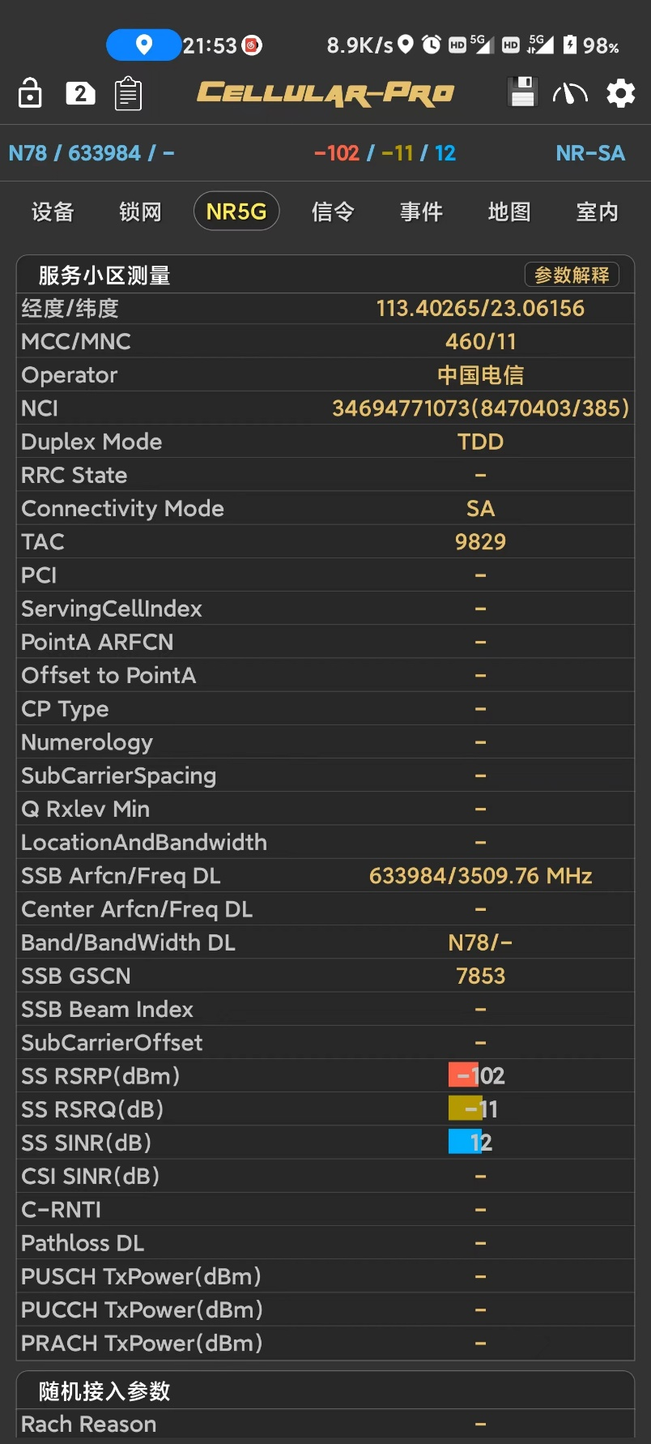
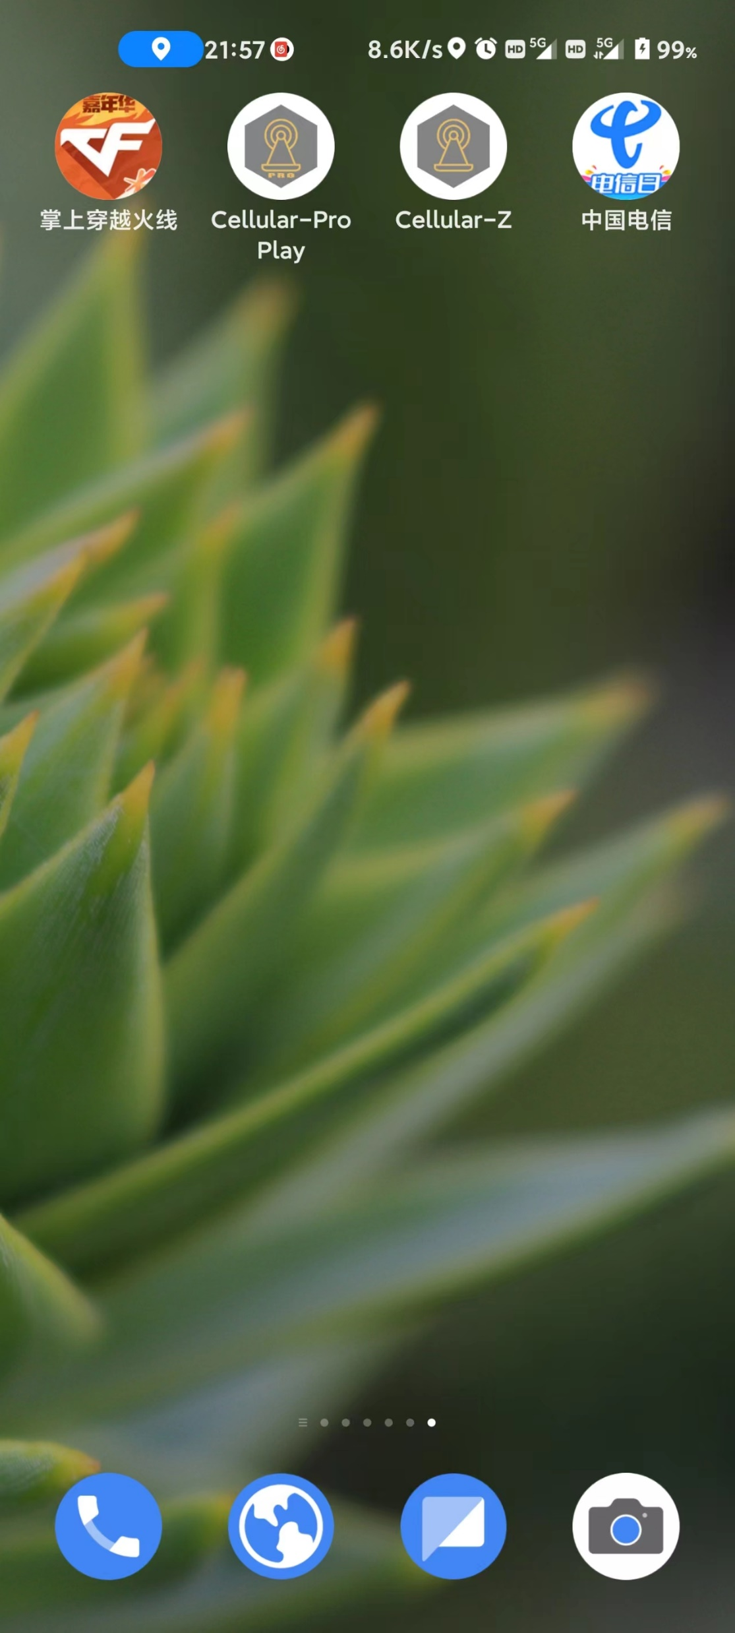
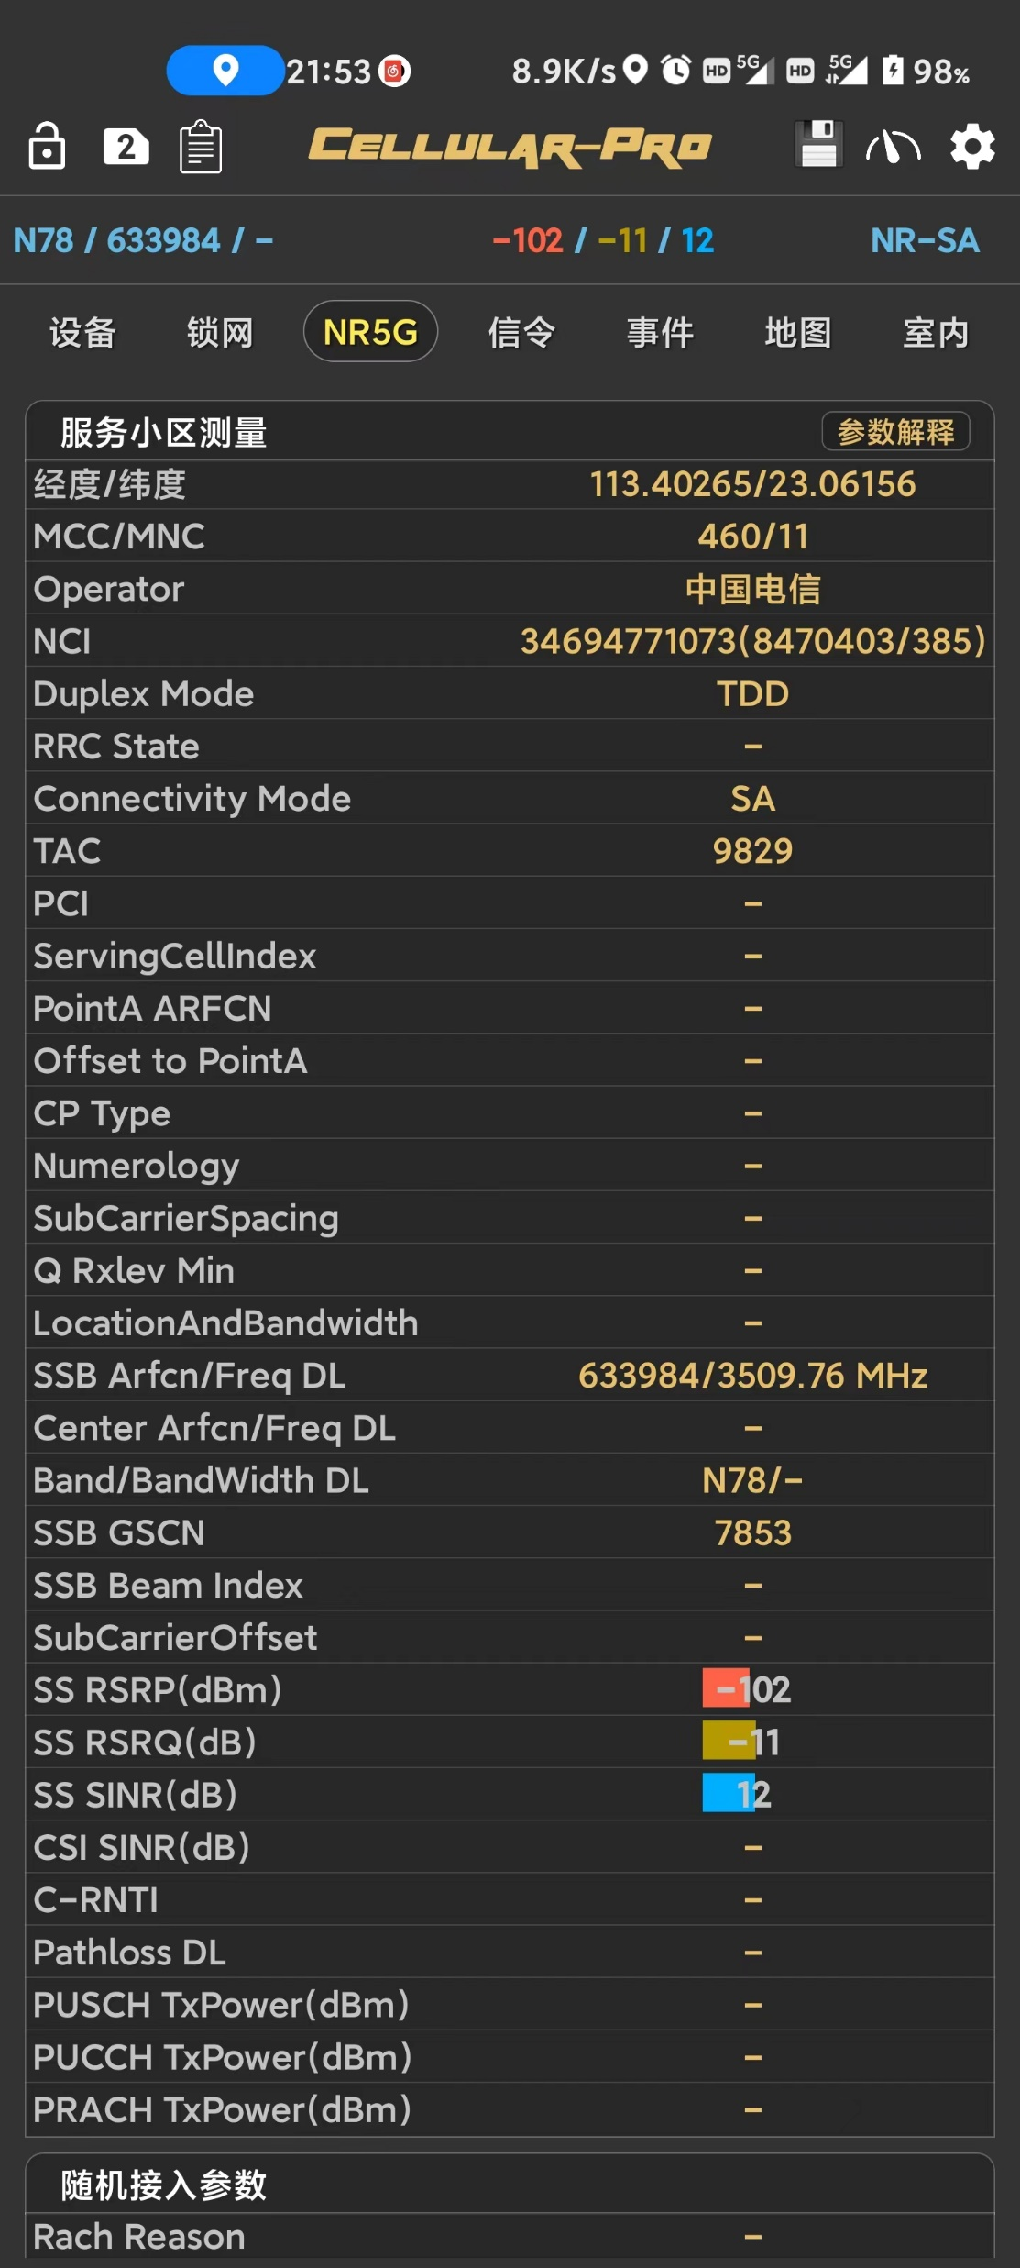
Operator | Frequency band number | Frequency Range(MHz) | Bandwidth(MHz)
China Mobile | n41 | 2515-2675 | 160
 | n79 | 4800-4900 | 100
China Telecom & China Unicom | n78 | 3300-3400 | 100
China Telecom | n78 | 3400-3500 | 100
China Unicom | n78 | 3500-3600 | 100

Slide 20
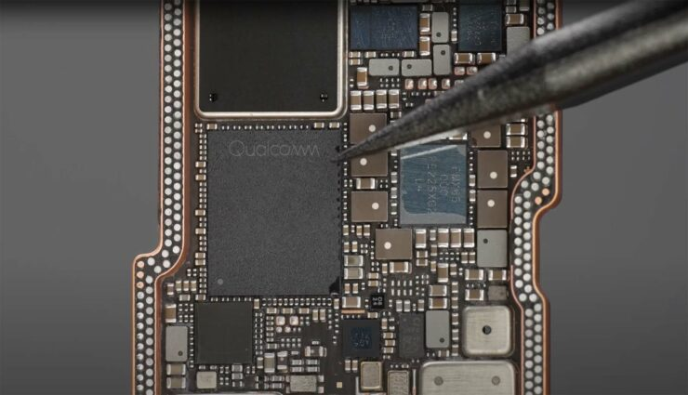
Baseband chip: A modem on your phone
A baseband processor(chip) is used to synthesize the baseband signal to be transmitted or to decode the received baseband signal. Without it, our phones would be unable to use mobile networks.

Slide 21
Baseband chip: A modem on your phone
Qualcomm relies on its decades of technology accumulation and patents in the baseband field to lead the market share of baseband chips.

Slide 22



Baseband processor: A modem on your phone
iPhone
Apple has been trying to develop its own baseband chips, but so far there has been no actual results. Current iPhones still use expensive Qualcomm plug-in basebands.
Huawei
Huawei has been known for its strong self-developed mobile phone basebands in the past few years. After chip bans from the United States, the latest mate 60 also implements self-developed 5G baseband chips.
Android phones like Samsung…
Since integrated baseband chips save more space inside mobile phones than plug-ins, mobile phone manufacturers generally use basebands integrated into the CPU by processor manufacturers.

Slide 23
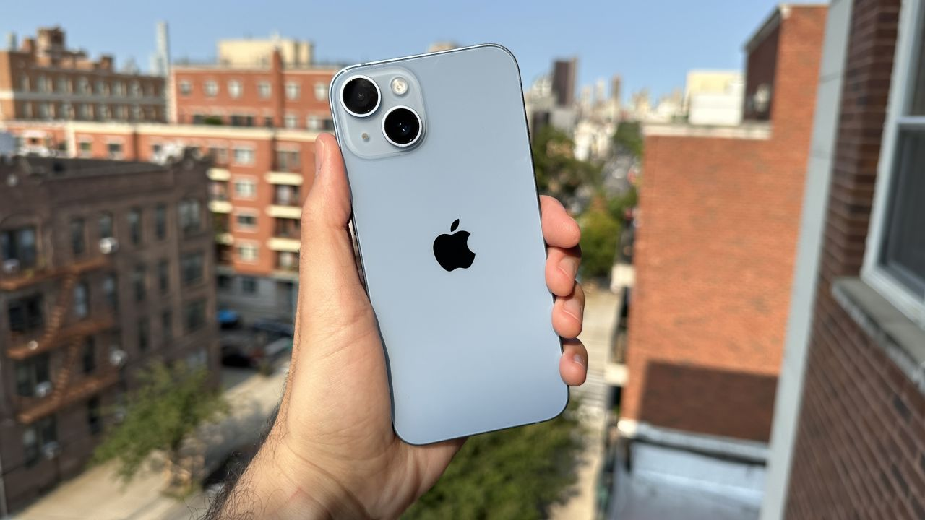
Baseband processor: A modem on your phone
iPhone
Apple has been trying to develop its own baseband chips, but so far there has been no actual results. Current iPhones still use expensive Qualcomm plug-in basebands.
Huawei
Huawei has been known for its strong self-developed mobile phone basebands in the past few years. After chip bans from the United States, the latest mate 60 also implements self-developed 5G baseband chips.
Android phones like Samsung…
Since integrated baseband chips save more space inside mobile phones than plug-ins, mobile phone manufacturers generally use basebands integrated into the CPU by processor manufacturers.

Slide 24
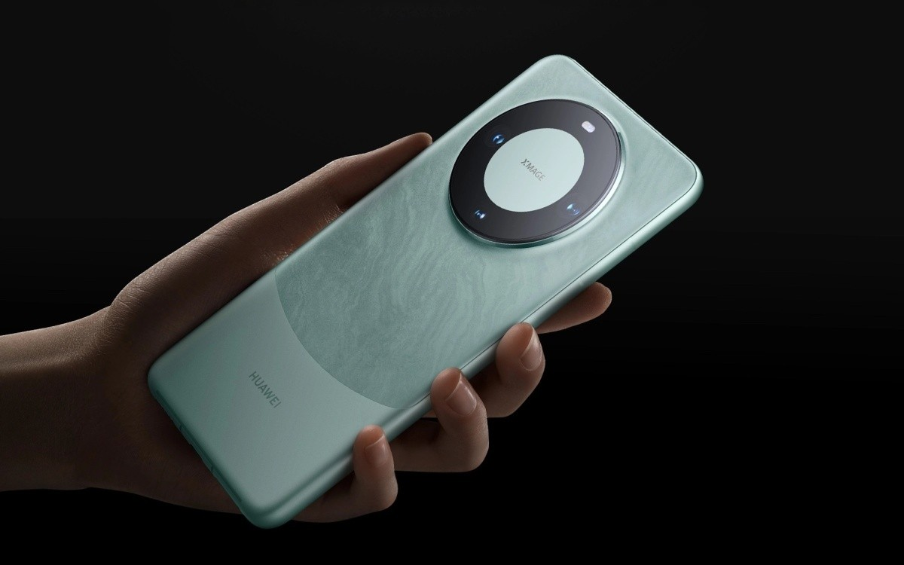
Baseband processor: A modem on your phone
iPhone
Apple has been trying to develop its own baseband chips, but so far there has been no actual results. Current iPhones still use expensive Qualcomm plug-in basebands.
Huawei
Huawei has been known for its strong self-developed mobile phone basebands in the past few years. After chip bans from the United States, the latest mate 60 also implements self-developed 5G baseband chips.
Android phones like Samsung…
Since integrated baseband chips save more space inside mobile phones than plug-ins, mobile phone manufacturers generally use basebands integrated into the CPU by processor manufacturers.

Slide 25
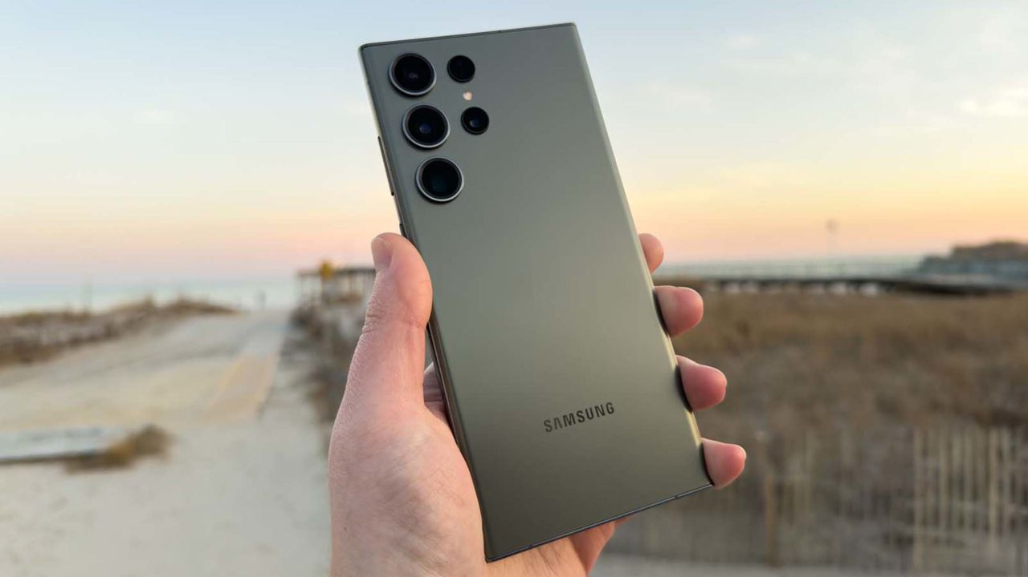
Baseband processor: A modem on your phone
iPhone
Apple has been trying to develop its own baseband chips, but so far there has been no actual results. Current iPhones still use expensive Qualcomm plug-in basebands.
Huawei
Huawei has been known for its strong self-developed mobile phone basebands in the past few years. After chip bans from the United States, the latest mate 60 also implements self-developed 5G baseband chips.
Android phones like Samsung…
Since integrated baseband chips save more space inside mobile phones than plug-ins, mobile phone manufacturers generally use basebands integrated into the CPU by processor manufacturers.

Slide 26
04
WIFI technology
by 鲁周徵
202130430393

Slide 27

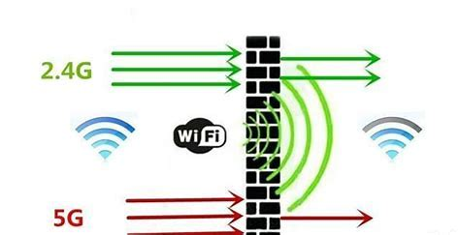
2.4G
5G
 | 2.4G | 5G
frequency range(MHz) | 2400~2483.5 | 5000~ 6000
propagation loss | low | high
penetration | good | strong
transfer rate | 150Mbps | 500Mbps

Slide 28

WIFI & 802.11
WIFI
WIFI is short for “Wireless Fidelity” and is a wireless local area network (WLAN) technology based on the IEEE 802.11 standard.
802.11
The 802.11 standard is for wireless local area networks (WLAN) and defines the physical layer and data link layer of wireless networks.

Slide 29
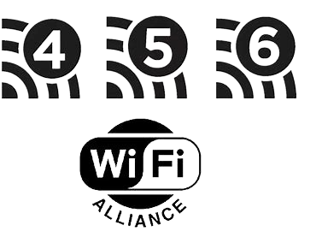
Comparison among wifi4, wifi5, and wifi6
WIFI Generation | Frequency Band (GHz) | Transfer Rate (Mbps) | Protocol
WIFI4 | 2.4GHz | 150Mbps | 802.11n
WIFI5 | 5GHz | 500Mbps | 802.11ac
WIFI6 | 2.4GHz and 5GHz | 1201Mbps | 802.11ax

Slide 30

05
NFC
Near-field communication
翟云天 202130430034

Slide 31

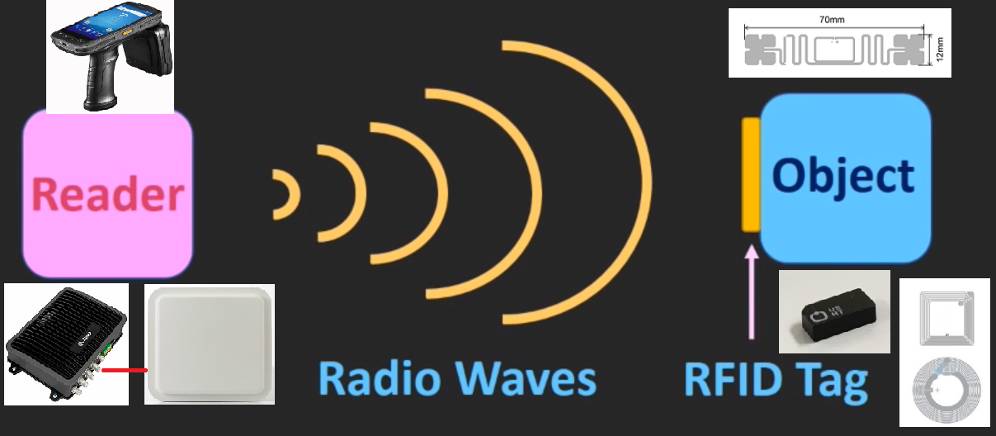
NFC and RFID
NFC
Communication between two electronic devices over a very short distance
RFID
Radio Frequency Identification
Use Radio signals (radio waves)
Item -- Tag

Slide 32

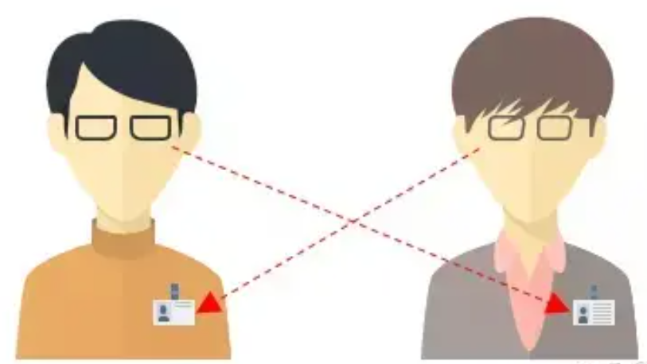
NFC and RFID
a work card around the neck of a staff member

Slide 33
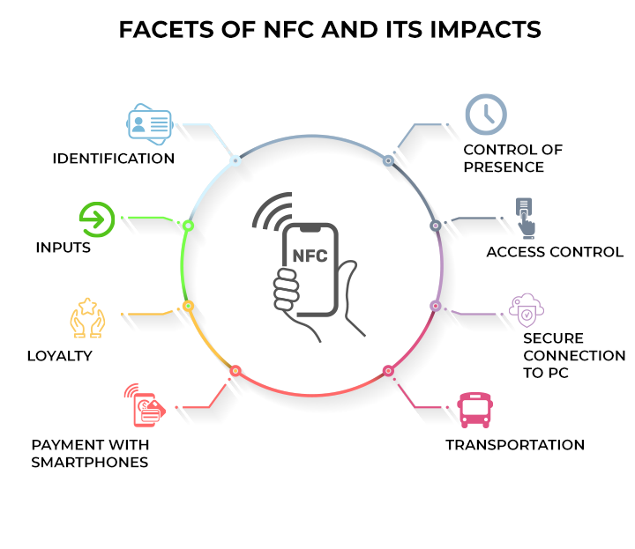
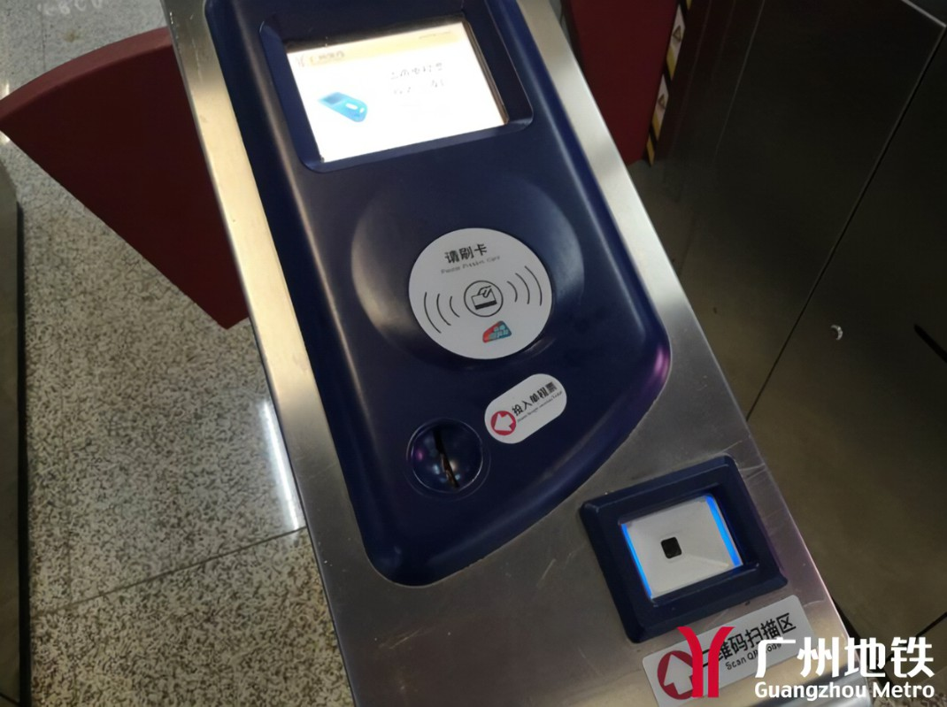
NFC in daily lives
1. Enter buses & metros
2. Open door gates
3. Mobile payment
and more ...

Slide 34
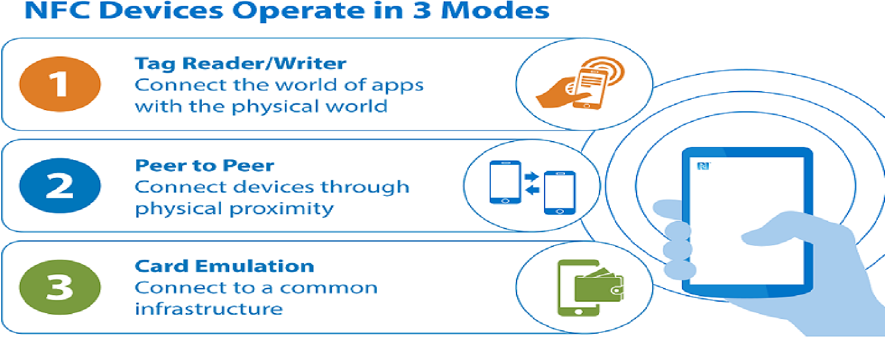
NFC’s three modes
Data stored in NFC chips
--Device connection
Data exchange between NFC devices
--Data transmission
Data stored in electronic devices (e.g. mobile phones) that support NFC
--NFC acts like an IC card

Slide 35
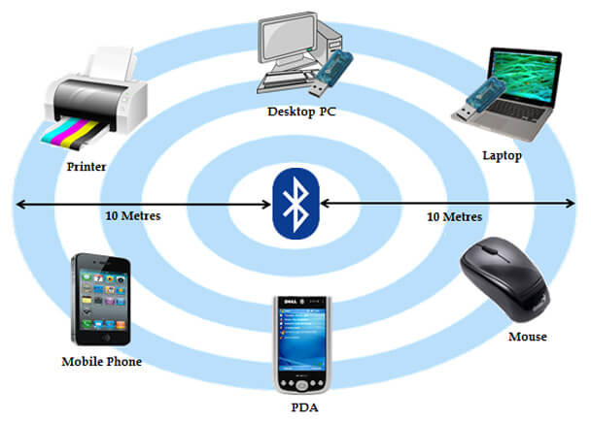
202169990213 - Shrestha Manish
Bluetooth
01
Wireless Personal Area Network (WPAN).
02
Range and Features.
03
Piconet.

Slide 36
07
The future
By 黄立刚 202130430065

Slide 37

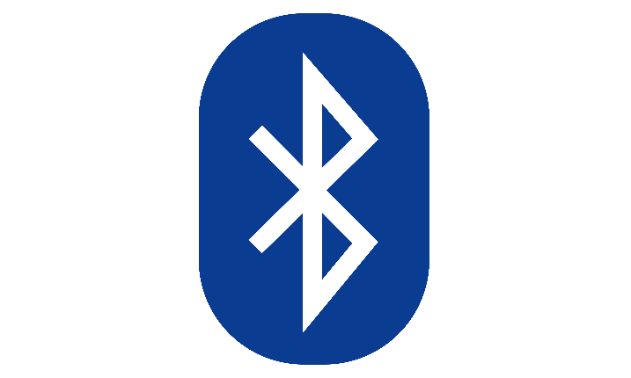



NearLink
Low power consumption
Higher speed
60%
6x
More stable linkage
Lower latency
+7dB
1/30

Slide 38

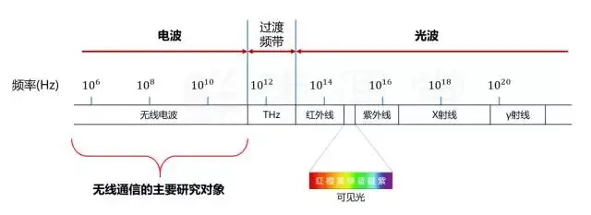
Modern wireless communications are based on electromagnetic waves.
But electromagnetic waves have limited spectral resources.
Why not use light waves?
Limited
Unused

Slide 39
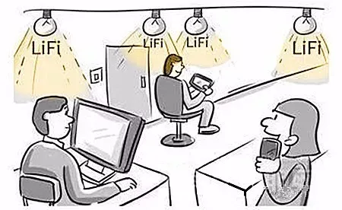
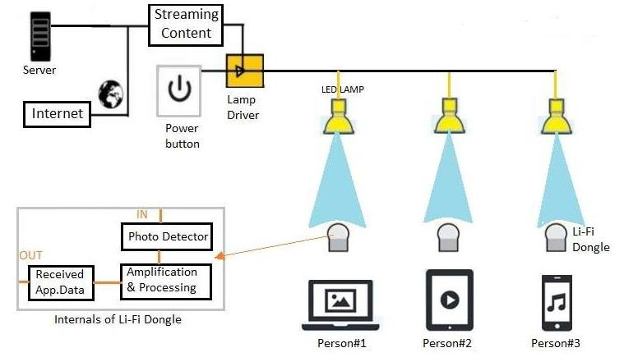
Principle is simple

Slide 40
Thank you
“Unplugged but Connected”

